Slide 1
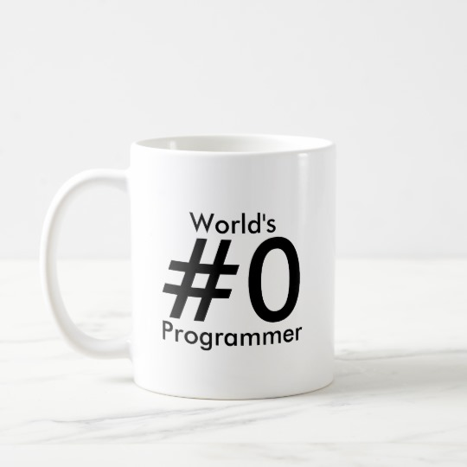
Lists

Slide 2

Lists
Concept:
A list is an object that contains multiple data items. Lists are mutable, which means that their contents can be changed during a program’s execution. Lists are dynamic data structures, meaning that items may be added to them or removed from them. You can use indexing, slicing, and various methods to work with lists in a program
Notes:
2

Slide 3
Lists
A list is an object that contains multiple data items.
Each item that is stored in the list is called an element
For example:
even_numbers = [2, 4, 6, 8, 10]
Elements are enclosed in brackets and separated by commas and may contain any data type
Notes:
3

Slide 4
Lists
Numeric Indexing
my_list = [10, 20, 30, 40]
my_list
10 | 20 | 30 | 40
0 | 1 | 2 | 3
Index Position
Notes:
4

Slide 5
Using Lists
To create a list we can tell Python the name of the list and what it will contain
To retrieve a list element we use the index position in []
from microbit import *
highScores = [25, 20, 10, 15, 30]
# Create a list and store some values in it.
print(highScores[0])
# Print 25
print(highScores[3])
# Print 15

Slide 6
Lists – In and Not In
Check if a value exists or doesn’t exist in a list using in or not in, e.g.:
mylist = ["pink","red","green","yellow"]
if "green" in mylist:
print("Found green!")
else:
print("No green")

Slide 7
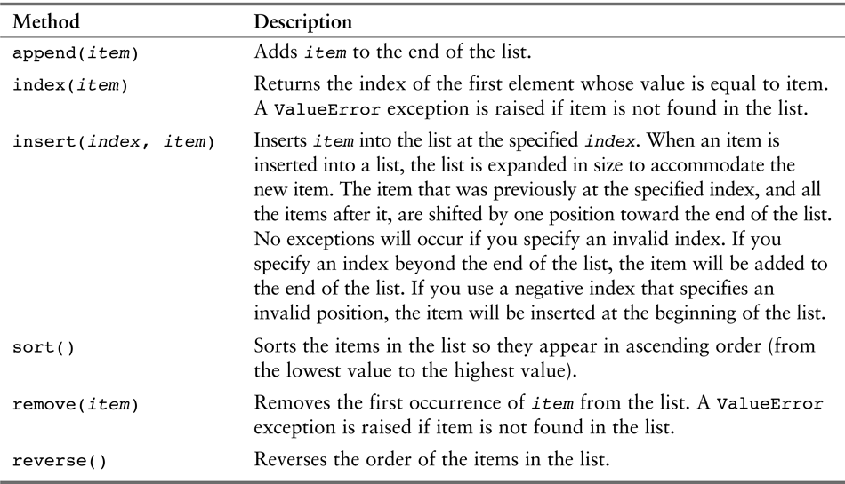
List Methods
Get list length using the len() function, e.g.
print(len(mylist))
Other helpful methods:
Notes:
7

Slide 8
Iterate Through List Example
mylist = ['hi', 'hi', 'hi']
# loop from 0 to list end length
for i in range(0,len(mylist)):
print(mylist[i])

Slide 9
Append Example
Create an empty array and use a loop to append() values onto the list:
from microbit import *
recordedTemperature = []
# Create an empty list
for i in (100):
# Add 100 temperature values
recordedTemperature.append(temperature())
sleep(1000)

Slide 10
Delete from a List
There are two ways to delete elements from lists – first, to delete an element with a particular value from a list:
highScores.remove(24)
Alternatively, you might want to delete an element at a specific position, if you know it:
highScores.pop(3)
<<or>>
del highScores[3]

Slide 11
Dictionaries and Tuples

Slide 12
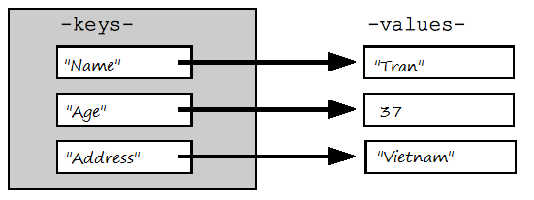
Creating and Using Dictionaries
Dictionaries are data structures as are lists and tuples
Specifically, dictionaries are mappings
Consist of key/value pairings
Each item in a dictionary has a unique key and with it a corresponding value

Slide 13
Creating and Using Dictionaries
The syntax to create a dictionary is as simple as enclosing the sequence of key value pairs in curly brackets, separating each key value pair with comas.
The separation of the key and the value is done with a colon.
mydictionary = {key1:value1,key2:value2…}
For example, creating a dictionary to store student ids (as keys) and grades (as values):
finalgrades = {"1324322":95,"9072245":85.5}

Slide 14
Accessing Dictionary Data
In order to access elements in a dictionary, we simply use square brackets and put inside the key to which we want to obtain the value, e.g.
testDictionary = {"key1": 1, "key2": "value2", "key3" : [1,2,3]}
print(testDictionary["key1"])
print(testDictionary["key2"])
print(testDictionary["key3"])

Slide 15
Dictionary Methods
len(d) returns # of items(key/value pairs) in d
d[k] returns value associated with key k
d[k] = v associates the value v with the key k
del d[k] deletes the item with key k
“k” in d checks whether there is an item in d that has the key k

Slide 16
Updating and Adding Elements
Updating and adding elements to the dictionary is the same process:
We use square brackets enclosing the key for the value we want to add / modify and assign it a value.
If that key doesn’t exist, then the key value pair is added to the dictionary.
If it exists, then the value is updated.
emptyDictionary = {}
emptyDictionary["key1"] = "value1"
emptyDictionary["key1"] = "updatedValue1"

Slide 17
Dictionary “get” Method
Another way of accessing an element is by calling the get method on the dictionary object and pass as input the key.
This returns the value for the key, if it exists.
If the key doesn’t exist, this call will return a default value
myDictionary = {"key1": "value1", "key2":"value2", "key3": "value3"}
val = myDictionary.get("key1")
val = myDictionary.get("nonExistingKey")
val = myDictionary.get("nonExistingKey", "the item was not found")

Slide 18
Tuples
Tuples are sequences, just like lists
Tuples cannot be changed, i.e. they are immutable
Tuples use parentheses, whereas lists use square brackets, e.g.
y = (1, 2, 3)
# create tuple
Any data printed out from your Micro:Bit as a tuple can be graphed in the plotter:
https://codewith.mu/en/tutorials/1.0/plotter

Slide 19
Examples

Slide 20
Data Structures + Images
Exercise 1: Create a list with 5 or 6 strings containing your favorite built-in images for the Micro:Bit
e.g. “Image.HEART”, etc.
Use a loop to display the first image, sleep for 3 seconds, then show the second image, sleep for 3 seconds, etc.
Exercise 2: Modify your code to use a dictionary to store the image data.
Revise your loop to iterate through the dictionary

Slide 21
Sensors + Plotter
Exercise: Pick an external sensor that provides data output, e.g. the light sensor, the water sensor, moisture sensor, etc.
Wire the sensor to connect to your M:B, read data at interval
Print out data as a tuple, e.g.:
temp = temperature()
pushed = button_a.get_presses()
print((temp,pushed)) # create tuple
Open the plotter while your program is running and check that the tuples are being plotted correctly!

Slide 22
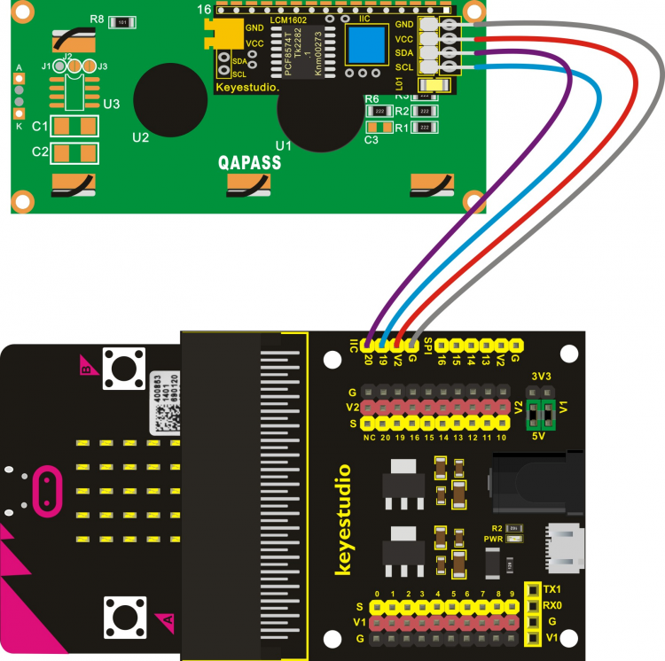
LCD Screen
https://github.com/Pratt-Institute/info697/blob/master/lcd_demo.py
Wire your LCD as shown, to the IIC pins (make sure the power jumpers are in 5V position)
Add this library to your MB via the Files button:
https://github.com/Pratt-Institute/info697/blob/master/mb_i2c_lcd1602.py
from mb_i2c_lcd1602 import *
l=LCD1620()
l.puts('Hi',1,4)

